Slide 1
Cloud BU – hackathon
Team name : Focus
Project Title : black jack
TEAM MATES : Madhuri
Lavanya
Chaitanya
Vijay
Nagesh

Slide 2
Black JAck
It is the most widely played casino banking system as it uses a deck of 52 cards , In this game one player
competes his cards with the cards of the dealer and comparatively check the winner.
HISTORY
1) Black Jack’s immediate precursor was the English version of the twenty-one called the “Vingt-Un”
2) The first game was ever played in the France around 1888 and in the Britain during the early 1770’s ,1780’s
RULES TO PLAY THE CASINO:
At the table, the dealer faces 5 to 9 positions behind the semi circular table. The 52 cards from the deck are distributed to the players (2 each) and players place their bets in the betting box
The dealer deals from the left to right
Each box gets an initial hand of two cards visible to the people playing on it. The dealers hand gets its first card face up and, in “Hole card” games, immediately gets second card face down which the dealer peeks at but only reveals when it makes the dealers hand a Black Jack
Number cards count as their number, (The Jack , Queen and King) which are face cards have a value of 10 and the aces count as either 1 or 11 according to the players choice. If the total exceeds 21 points it Busts and all bets on it immediately loose
The object is the game is to win money by creating card totals higher than those of the deals and but not exceeding 21

Slide 3
Total Cards :
Total we have 52 cards
CARDS:
Aces – A
Queen – Q
King – K
Jack – J
NUMBERS:
2,3,4,5,6,7,8,9,10
CARD VALUE:
A – 1/11
Q – 10
K – 10
J – 10

Slide 4
Player options:
Black Jack : Total number should be 21 by 2 cards (AJ or AL or AQ)
Natural : Total number should be 21 by 2 cards (A10,A9,Q2,K6,…etc)
After the initial two cards, the player has up to 5 options “Hit”, “Stand”, “Double-down”, “Split” and “Surrender”
Hit : Take a card
Stand : End their turn and stop without taking card
Double : Double their wages, taking a single card and finish
Split : If two cards having same value then separate them to make the two hands
Surrender : Give-up a half bet and come out from the game
Busts : Total is greater than 21, we loose all the bet immediately

Slide 5
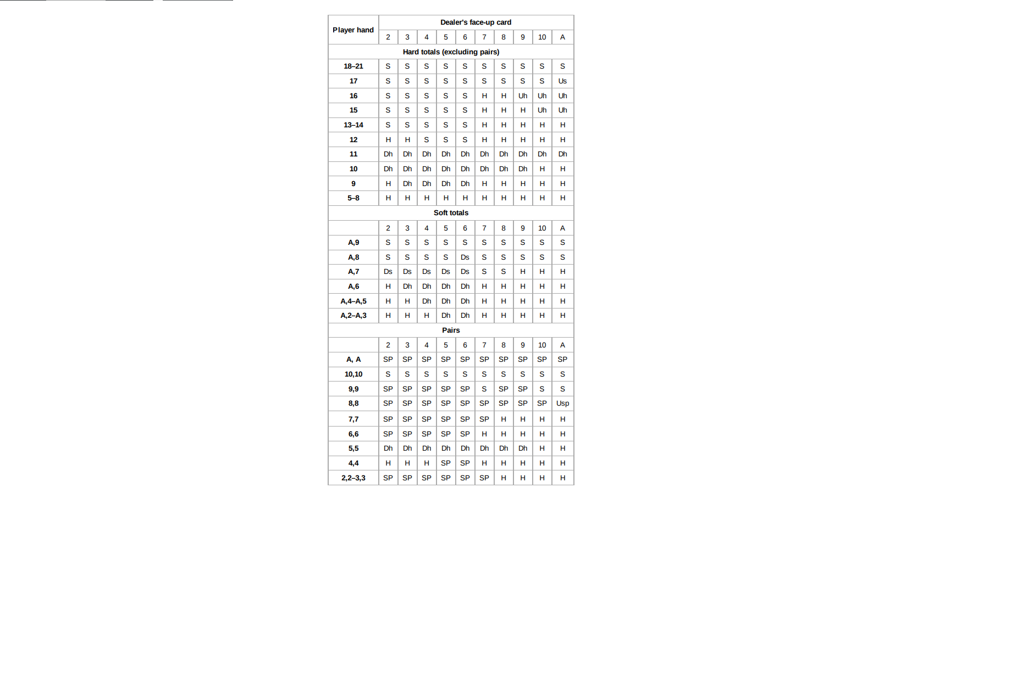

Key: S = Stand
H = Hit
Dh = Double (if not allowed, then hit)
Ds = Double (if not allowed, then stand)
SP = Split Uh = Surrender (if not allowed,
then hit)
Us = Surrender (if not allowed, then stand)
Usp = Surrender (if not allowed, then split)

Slide 6
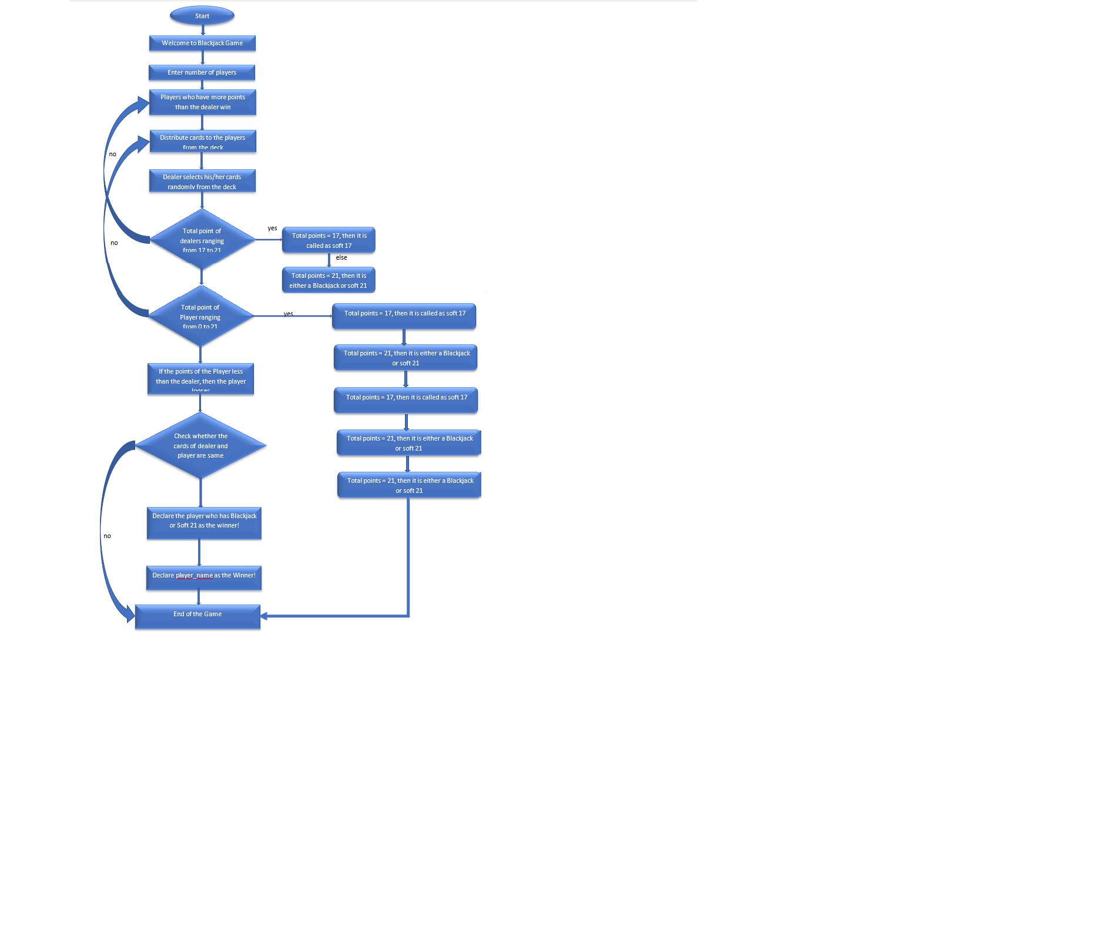
FLOW CHART
Flow Chart

Slide 7
The End

